Slide 1
Overview of AWS Services
→By Team AWS ERA

Slide 2
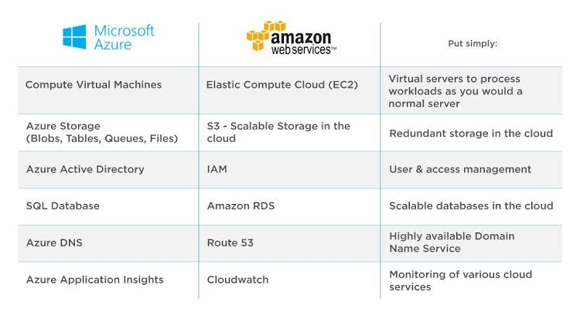
Services

Slide 3
EC2
It stands for Elastic Compute Cloud and It provides resizable compute capacity in the Aws cloud.
Ec2 instances can be resized and the number of instances scaled up (or) down as per our requirement.
Ec2 launch as many (or) as few virtual servers as you need, configure security & network & manage storage.

Slide 4
S3
S3-It stands for Simple Storage Service
Its provides access to reliable & inexpensive date storage infrastructure and enabling you to store and retrieve any amount of data, at any time from with in Amazon Ec2 (or) anywhere on the web.
S3 max bucket count-100 per a/c
The size limits of objects stored in the bucket is 5TB.

Slide 5
IAM
IAM-Identity And Access Management
It enables you to manage access to AWS services & resources securely.
Users→ It has permanent long-term credentials and is used to directly interact with AWS services.
Groups→ It is a collection of IAM users.
Roles→ It defines the set of permissions for making AWS service request.

Slide 6
RDS
RDS-Relational Database Services
It supports MySQL, Amazon Arora, Postgre SQL, Maria DB, MsSQL, Oracle engines.
It is a collection of data items are organized as a set of tables with Columns & Rows.

Slide 7
Route 53
It is a highly available and scalable cloud domain name system(DNS) web service.
It is designed to give developers and businesses an extremely reliable & cost effective way to route end users to internet applications by translating names like www.example.com into the numeric IP address.

Slide 8
Cloud Watch
It monitors your AWS resources and the applications you run on AWS in real time.
You can use Cloud Watch to collect and track metrics, which are variables you can measure for your resources and applications.
You can create alarms that watch metrics and send notifications.

Slide 9
Thank you

